Slide 1

Camelina Oil for Sustainable Aviation Fuel Production
A scenario assessment for recovering European degraded soils
Maria Giovanna Sessa
DISTAL – University of Bologna
Marco Buffi
Joint Research Centre – European Commission

Slide 2

The EU Aviation Decarbonization Challenge
The EU aviation sector faces urgent pressure to integrate renewable energy, with Sustainable Aviation Fuels (SAF) essential for short-term decarbonization. The EU Climate Law targets a 90% GHG reduction by 2040, while RED III and REFuelEU Aviation set progressively increasing SAF mandates through 2050.
RED III
REFuelEU Aviation
Updated Renewable Energy Directive sets a target of 42.5% renewable energy by 2030 and includes specific sub-targets for advanced biofuels from non-food feedstocks (Annex IX Part A).
All EU-departing flights are required to use a minimum share of SAF, rising progressively to 70% by 2050. The mandate covers synthetic fuels, advanced biofuels, and recycled carbon fuels.

Slide 3

Feedstock Classification: Defining Advanced Biofuels under RED II
Understanding the classification of feedstocks is crucial for defining advanced biofuels under RED II, ensuring sustainability and adherence to regulatory standards.
Annex IX Part A: Advanced Feedstocks
Annex IX Part B: Contributing Feedstocks
Non-food crops grown on degraded lands
Intermediate crops
Used Cooking Oil (UCO)
Animal fats
Degraded Land Definition under RED II
”Land that for a significant period of time has either been significantly salinized, presented significantly low organic matter
content and/or has been severely eroded.”
Soil organic matter (SOM) threshold: <3.4% SOM combined with soil loss erosion >1.5 t/ha/yr
Salinity Threshold: ≥4 dS/m electrical conductivity
Note: Intermediate crops are not explicitly defined in RED II, leading to uncertainty in their eligibility.

Slide 4




The Role of Oilseed Crops
in Aviation Decarbonization
Oilseed crops are particularly interesting for both degraded land use and intermediate cropping systems, as they can support the decarbonization of aviation by providing sustainable lipids for HVO/HEFA fuels. In recent years, the European Union has funded many projects aimed at identifying alternative feedstocks for the bio-based and bioenergy sectors.

Slide 5
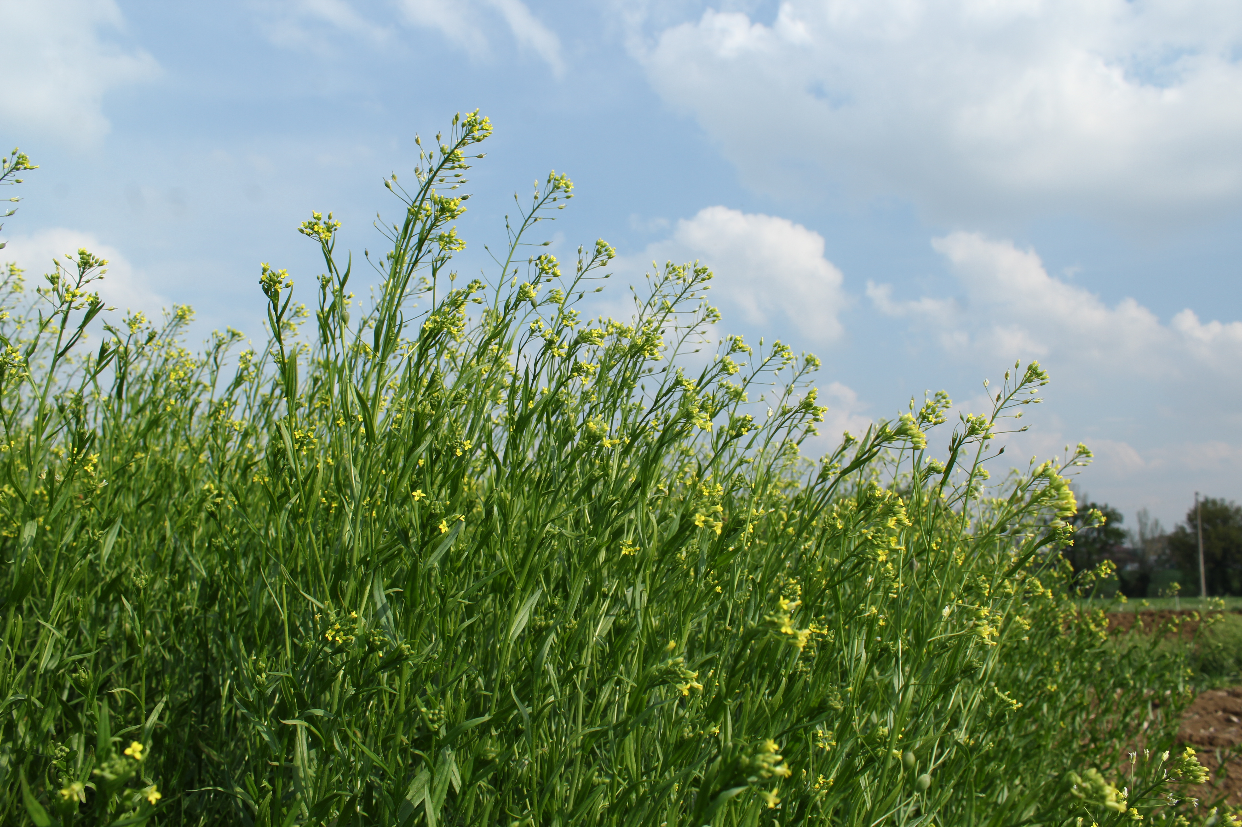

Camelina sativa (L. Crantz)
Camelina, an annual oilseed crop of the Brassicaceae family, is a promising candidate as SAF feedstock due to its low input requirements, short growing cycle, and adaptability to marginal and degraded soils across Europe.
0.9-1.9 t/ha
Seed Yield
Grown on marginal land in Europe
1200 Growing Degree Days
Cycle Length
Winter and spring varieties for flexible rotation
24-46%
Oil Content
Rich in omega-3 fatty acids
Camelina photos taken at the Experimental Farm of the University of Bologna

Slide 6

Aim of the study
Evaluate the technical, environmental, and economic feasibility of camelina-derived SAF production on degraded Mediterranean lands under current EU policy frameworks.
Specific Objectives
Evaluate supply chain integration and regional production potential.
Quantify carbon intensity pathways under RED III eligibility criteria.
Model GHG reduction potential through carbon farming and soil carbon sequestration.
Assess economic viability and cost-competitiveness relative to conventional SAF pathways.

Slide 7

The CAM-BAR Agricultural Model
This study was based on the CAM-BAR model (camelina in rotation with barley) (Schillaci et al., 2023), integrating the ARMOSA process-based crop, soil and climate data, and focusing of Mediterranean region where soil degradation is more severe.
CLC land cover
Non‑irrigated arable land
Land Eligibility for Camelina
Camelina yield threshold
Soil organic carbon
Yield ≥ 1.4 t/ha/yr
Top 20cm ≤ 1.7% SOC

Slide 8
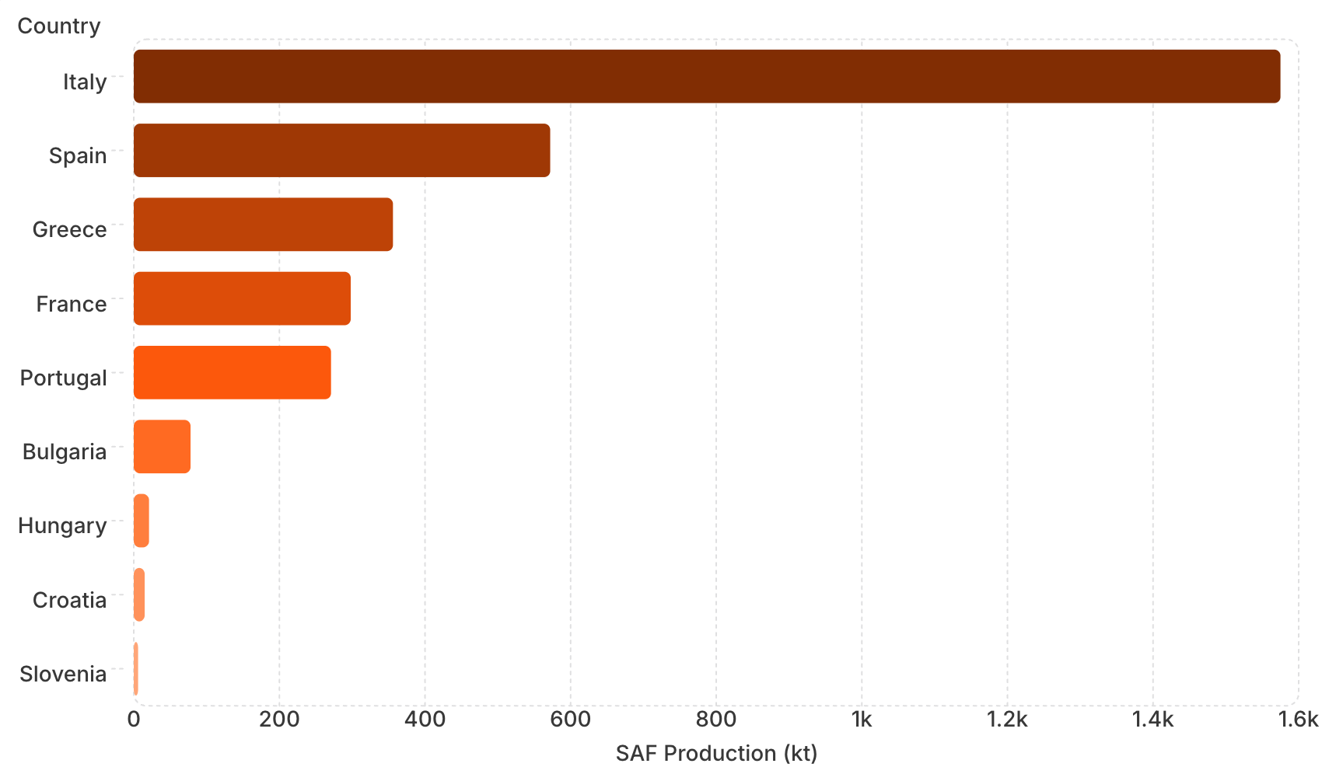

SAF Production Potential Across the EU
Key Findings
116,000 km² of available degraded land identified across the EU, capable of producing 3.2 Mtoe/year of SAF.
Italy is the main contributor with over 50% of total EU potential (1.65 Mtoe), followed by Spain (~20%). Greece, France, and Portugal contribute the remaining 30%. Central EU countries contribute less than 0.1%.
The HRJ process also yields ~506 kt LPG, 730 kt naphtha, and 805 kt diesel — additional decarbonization opportunities.

Slide 9
Carbon intensity evaluation methodology (RED)
The carbon intensity (CI) of camelina-derived Sustainable Aviation Fuel (SAF) was determined according to RED framework through attributional LCA approach and expressed in gC0₂eq per MJ. The methodology accounts for CO₂, CH₄, AND N₂O across the full fuel lifecycle.
GHG emission calculation formula
e_{c}: Extraction and cultivation
e_{l}: Land-use change
e_{p}: Processing
e_{t}: Transport and distribution
e_{u}: Fuel combustion
e_{sca}: Soil carbon accumulation
e_{ccs}: Geological storage
e_{ccr}: CO₂ capture
Fossil fuel comparator
Under RED II, the functional unit is 1 MJ of fuel, compared against a fossil fuel comparator of 94 g CO₂eq/MJ.
Minimum GHG savings threshold
Advanced biofuels must achieve a minimum 65% GHG savings versus the fossil comparator to qualify under RED II.

Slide 10
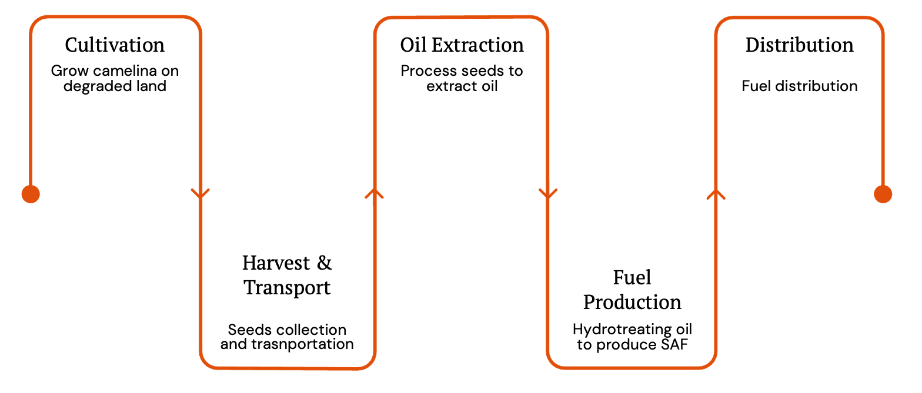





Full value chain evaluation

Slide 11
Carbon Intensity of SAF Pathways
Camelina-based SAF (standard) obtained a carbon intensity of 39.5 gCO₂eq/MJ — above the RED II eligibility threshold. However, when accounting for soil carbon accumulation (e_{sca} = 25 gCO₂eq/MJ) and the degraded land bonus (29 gCO₂eq/MJ):
Standard + credits: −3.2 gCO₂eq/MJ (∽103% GHG savings).
Best case: −30.8 gCO₂eq/MJ (∽133% GHG savings).
SAF derived from camelina evaluated with credits and the best case scenario outperforming both UCO and tallow, positioning camelina as a highly competitive low-carbon SAF feedstock.

Slide 12
Economic Assessment
The value chain covers camelina cultivation (minimal tillage, 50 kg N/ha), oilseed harvesting (swathing + combining or direct combining), oil extraction (38% lipid efficiency), and hydrotreating to maximize jet fuel yield (53.5 kg jet per 100 kg oil).
2220€
1797€
Camelina SAF Cost
UCO SAF Cost
Mean production cost per tonne, driven ~80% by feedstock price
Mean production cost per tonne from used cooking oil
1326€
950€
Camelina Oil Price
UCO Market Price
Estimated selling price per t in 2025 (33% increase from 2017)
Current market selling price per tonne (CIF Rotterdam)
The cost gap between camelina and UCO-based SAF (~423 €/t) represents the primary economic barrier, though carbon crediting mechanisms can help offset this difference.

Slide 13
Conclusions
This research provides the first unified scenario connecting camelina cultivation on degraded lands with RED certification requirements — integrating agronomic modeling, soil carbon assessment, policy-compliant GHG accounting, and techno-economic analysis.
Low-iLUC risk: Thrives on degraded lands with SOC ≤ 1.7%, avoiding competition with food crops.
Mediterranean-ready: Well-adapted to regional climates and marginal soils.
Exceptional CI: Best-case carbon intensity of -30.8 gCO₂eq/MJ.
Carbon farming co-benefits: Promotes soil carbon accumulation.

Slide 14
Future Research Directions
01
02
Expand Crop Assessment
Defining Intermediate Crop
Extend methodology to other oilseed crops for SAF to build a broader low-iLUC feedstock portfolio.
Assess the performance of intermediate crops under real Mediterranean field conditions.
03
04
Full Sustainability Profiling
Validate Low-iLUC Status
Quantify GHG emissions, yield stability, and soil carbon sequestration across diverse Mediterranean cropping systems.
Confirm eligibility under EU RED II framework for policy-aligned SAF pathways.

Slide 15
THANK YOU
Maria Giovanna Sessa
mariagiovanna.sessa2@unibo.it

